Slide 1
MapReduce Vs Spark
Comprehensive Comparison With Steps Included
Name: A.K. Gamage
Index: 239316C

Slide 2

About Me
Name: Adheesha Gamage
Hometown: Ambalangoda
Occupation: Systems and Solutions Engineer
Employer: Axiata Digital Labs Pvt. Ltd
Education
2002-2015 : Dharmasoka College, Ambalangoda
2016-2021: University of Moratuwa, Department of Electronic And Telecommunication Engineering - BSc (Hons) In Engineering
Present : Pursuing Msc. in CS at CSE, University of Moratuwa
Contact: 0719090733
Email: gamageak.23@uom.lk

Slide 3

Introduction To Spark and MapReduce
Spark
Apache Spark is an open-source distributed computing framework designed for processing large-scale data sets in a distributed and parallel manner
Spark supports multiple programming languages including Scala, Java, Python, and R
provides a unified processing engine for batch processing, real-time streaming, graph processing, and machine learning workloads
Used for variety of data processing use cases, including ETL (extract, transform, load), data warehousing, analytics, and machine learning.
Spark also includes a variety of built-in libraries, such as Spark SQL, Spark Streaming, and Mllib
Apache Spark is available as a managed service on Amazon EMR

Slide 4

Introduction To Spark and MapReduce
MapReduce
MapReduce is a programming model and processing framework for distributed computing on large data sets
MapReduce was popularized by Apache Hadoop, an open-source implementation of the MapReduce framework
In the MapReduce programming model, data processing tasks are broken down into two stages: a Map stage and a Reduce stage
The Map stage processes input data and produces intermediate key-value pairs, while the Reduce stage aggregates the intermediate results based on the key and produces final output.
MapReduce provides fault-tolerance, scalability, and efficient processing of data by parallelizing computation across multiple nodes.
Amazon Web Services (AWS) offers a managed service for MapReduce called Amazon Elastic MapReduce (EMR)

Slide 5

Objective
Use Hadoop Distributed File System(HDFS) to Store the Given Dataset
Use MapReduce along with Hive for processing and analyzing the dataset
Use Spark to analyze dataset Using Spark-SQL
Compare the differences of between MapReduce and Spark with regards to ease of use and fast process

Slide 6
Prerequisites
Dataset
Uses An Air Line delay Dataset for the Experiment
Data Description: https://www.kaggle.com/code/adveros/flight-delay-eda-exploratory-data-analysis/notebook
Create AWS EMR Cluster
The Cluster need to have Hive and Spark Enabled
Create S3 Bucket
An S3 Bucket Need to be created
Dataset Will Be loaded to this S3 Bucket For reference

Slide 7
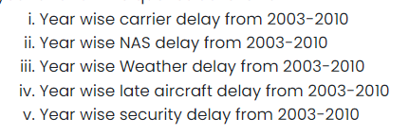
Processing Queries With Spark
The Following Queries were run with Spark to be compared with Map Reduce Result
Queries were run in by using ssh connection to master node of EMR cluster
Spark-submit <codeFIle> was used to execute each query
Please refer Below Git Repo for the codes and Results
https://github.com/adheeshagamage/UoM_MapReduce-vs-Spark/blob/main/UoM_MapReduce-vs-Spark/Spark/

Slide 8
Processing Queries With Hive and MapReduce
The Following Queries were run with MapReduce using Hive HQL Scripts
Queries were run in by using ssh connection to master node of EMR cluster
Hive -f <codeFIle> was used to execute each query
Please refer Below Git Repo for the codes and Results
https://github.com/adheeshagamage/UoM_MapReduce-vs-Spark/blob/main/UoM_MapReduce-vs-Spark/MapReduce/

Slide 9
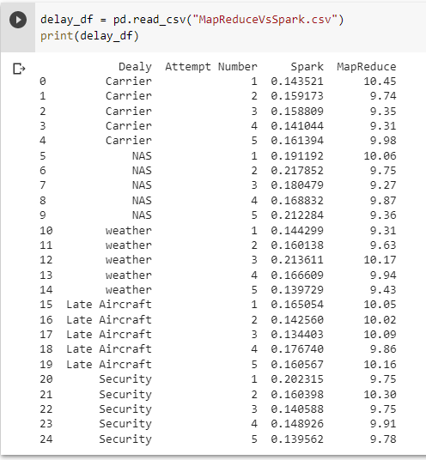
Experiment Results

Slide 10
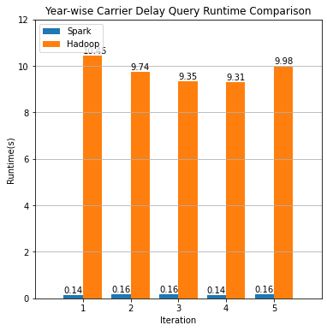
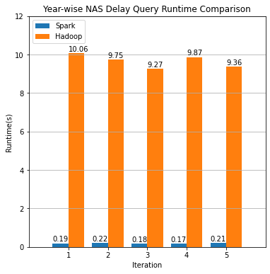
Comparison Graph of Each Query Runtime(For Five Iterations)

Slide 11
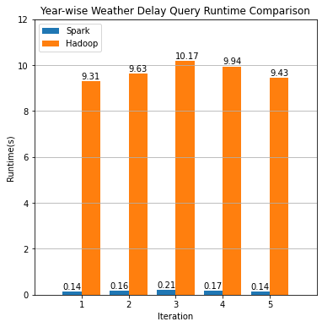
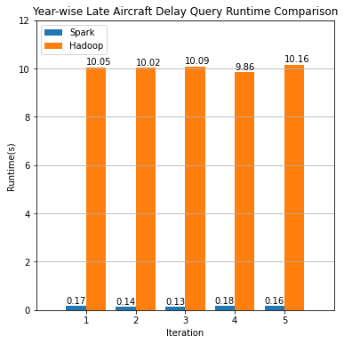
Comparison Graph of Each Query Runtime(For Five Iterations)

Slide 12
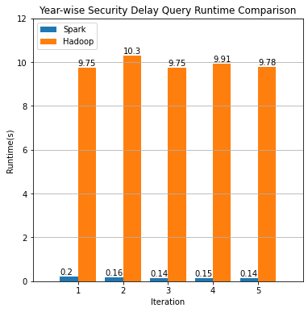
Comparison Graph of Each Query Runtime(For Five Iterations)

Slide 13
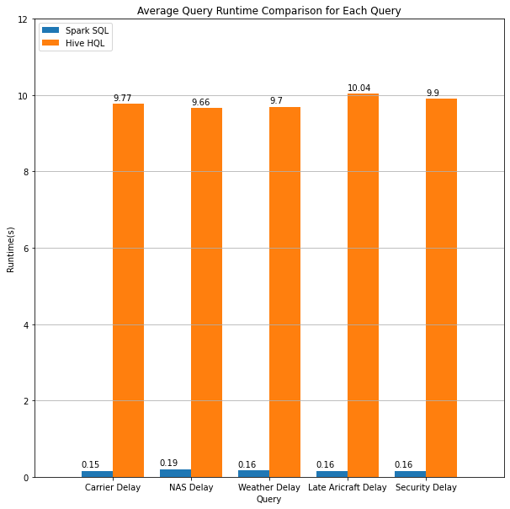
Comparison Graph For Average Query Runtime For Each Query

Slide 14
Comparison Between Spark And Map Reduce
Ease Of Use
MapReduce needs developers to write custom codes using programming language to perform data processing.
It requires a solid understanding of programming and data structures.
MapReduce needs developers to manually manage and optimize data partitions.
On The Other hand, Apache Spark gives a higher-level programming interface. So easier for development
Spark supports multiple programming languages
provides a set of pre-built data processing operations, such as filtering, aggregation..etc
Unlike MapReduce, Spark automatically manages data partitions.

Slide 15
Comparison Between Spark And Map Reduce
Fast Process
From The experiment we can see that Apache Spark is much faster than MapReduce in processing.
This is Mainly Due to its use of in memory Processing
Spark also uses a DAG (Directed Acyclic Graph) execution engine, which optimizes the order of operations and reduces the amount of data shuffling needed between nodes.

Slide 16

Conclusion
From the results obtained and the discussions had, we can conclude that, even though both MapReduce and Apache Spark are used for distributed big data processing, Spark is much easy to use due to its high-level programming interface and faster processing times thanks to in memory processing and DAG Engine

